Slide 1
WOW!!!
THIS is really fascinating - it's rather dazzling to see it presented this way.

Slide 2
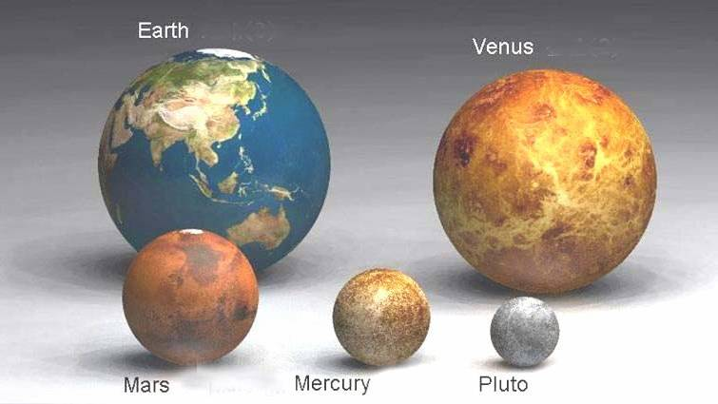

Slide 3
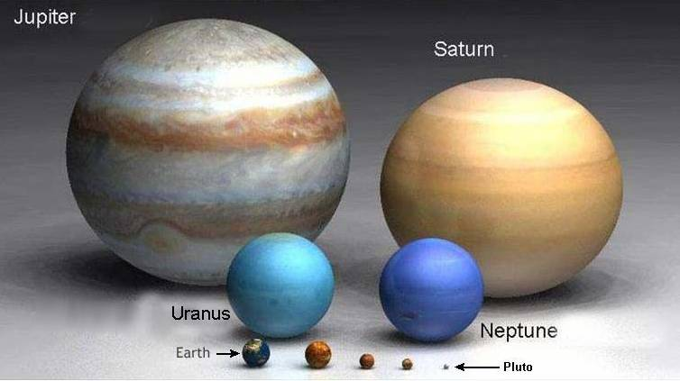

Slide 4
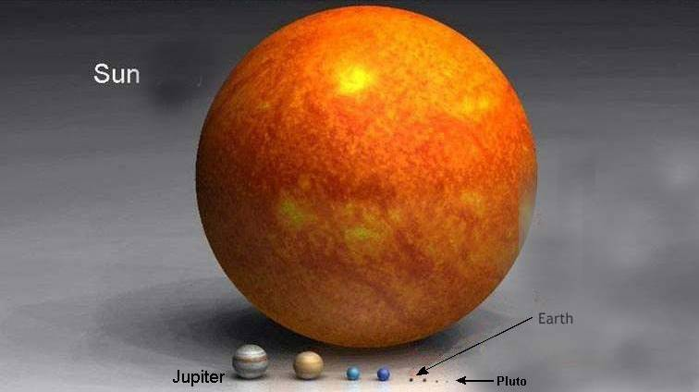

Slide 5
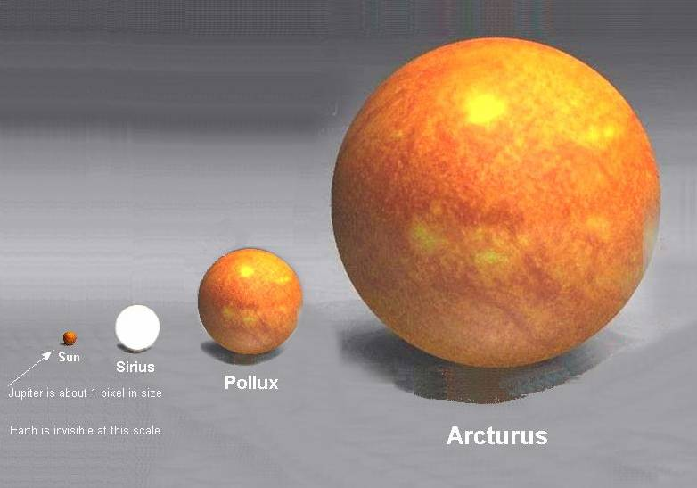

Slide 6
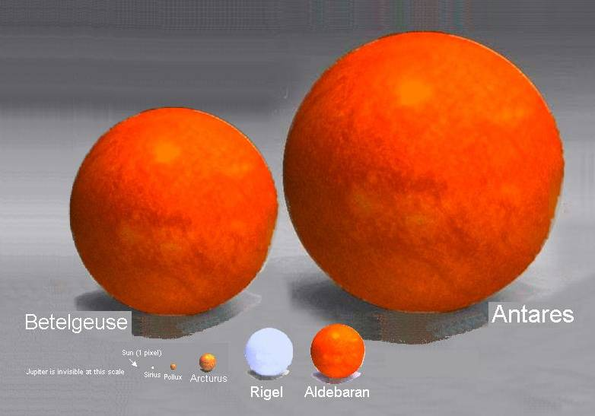

Slide 7
ANTARES
IS THE 15TH BRIGHTEST STAR IN THE SKY .
IT
IS MORE THAN 1000 LIGHT YEARS AWAY.
NOW HOW BIG
ARE YOU?

Slide 8
NOW
TRY TO WRAP YOUR MIND AROUND THIS.........

Slide 9
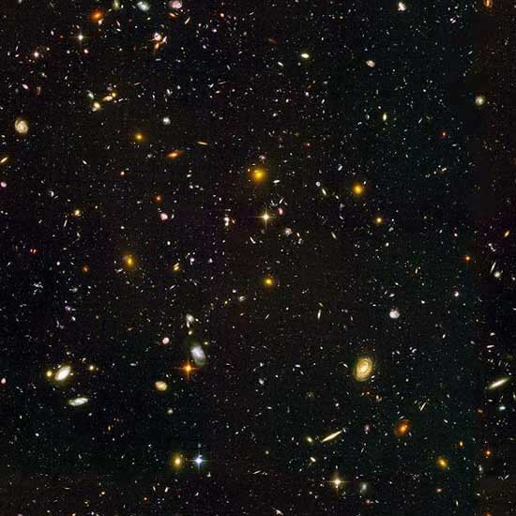
THIS IS A HUBBLE TELESCOPE ULTRA DEEP FIELD INFRARED VIEW OF COUNTLESS 'ENTIRE'
GALAXIES BILLIONS OF LIGHT-YEARS AWAY.

Slide 10
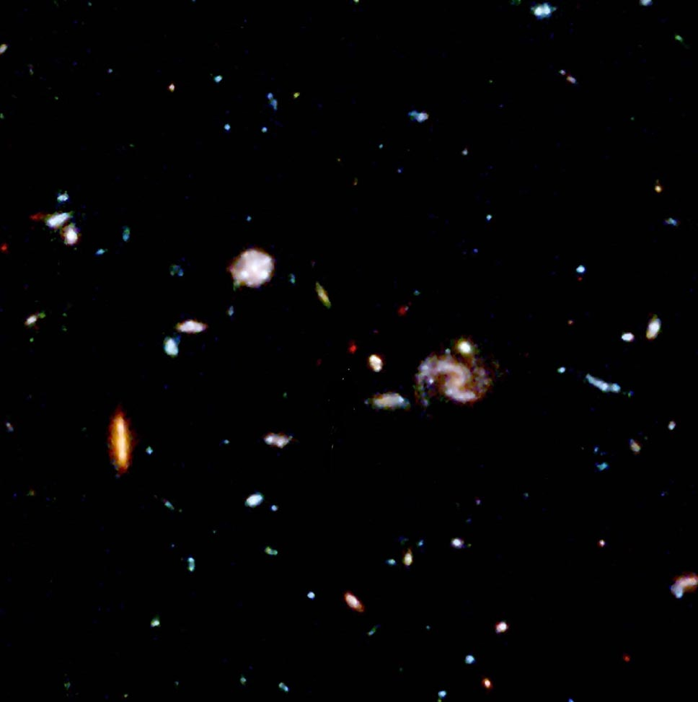
BELOW IS A CLOSE UP OF ONE OF THE DARKEST REGIONS OF THE
PHOTO ABOVE.

Slide 11
HUMBLING, ISN'T IT?
And Yet, Someone Knows how many hairs are on your head, And not Even a single sparrow dies apart from His Will
(Mt. 10:29-31)!
NOW: HOW BIG ARE YOU?
AND HOW BIG ARE THE THINGS
THAT UPSET YOU TODAY?
AND HOW BIG IS YOUR GOD?

